Slide 1
INTERNAL PROJECT: LM393 SPEED SENSOR
Mariano Q. Daga-ang Jr
March 1, 2023

Slide 2
1
1
FUCNTIONAL OVERVIEW
2
GPT MODULE DEPENDENCIES
CONTENT
3
GPT NOTIFICATION FUNCTION
4
LM393 SPEED SENSOR IMPLEMENTATION
© Copyright FPT Software – Level of Confidentiality

Slide 3
01. FUNCTIONAL OVERVIEW

Slide 4
GPT OVERVIEW
Gpt primarily used to generate different time bases that other modules of AUTOSAR could depend on. TDA4x, DRA80x class of devices includes multiple timers, below listed are some of the key features provided.
Free running 32 bit up counter
Auto reload mode (can be used for continuous counter operation)
Support dynamic Start / Stop counter operation
Programmable clock dividers (2n, where n = [0-8])
2 timers modules could be operated in cascaded mode to provide 64bit counter
Programmable interrupt generation on overflow, compare and capture
Programmable clock source

Slide 5
DRIVER DESIGN SUMARY
The GPT driver provides services for starting and stopping timer channels (logical timer
instances assigned to a timer hardware).
A timer channel can be configured and run in "one-shot mode" or in "continuous mode",
and the elapsed time and time remaining are also supported.
The GPT Driver implements maximum 38 channels on 4 types of S32K1XX peripherals.
32 channels are implemented on 8 FlexTimer (FTM) modules.
4 channels are implemented on Low Power Interrupt Timer (LPIT).
1 channels are implemented on Low Power Timer (LPTMR).
1 channels are implemented on Real Time Clock (SRTC).

Slide 6
LM393 SPEED SENSOR OVERVIEW
Widely used in motor speed detection, pulse count, the position limit, etc. The DO output interface can be directly connected to a micro controller IO port, if there is a block detection sensor, such as the speed of the motor encoder can detect. DO modules can be connected to the relay, limit switch, and other functions, it can also with the active buzzer module, compose alarm.
Features
The output state light, lamp output level, the output low level light.
Covered : output high level; Without sunscreen : the output low level.
The working voltage of 3.3 V to 5 V
Output form: digital switch output (0 and 1)
Small board PCB size: 3.2 cm x 1.4 cm
USES:
The module without slot, the receiving tube conduction, module DO output low level, shade, the DO output high level;
the DO output interface can be directly connected to a microcontroller IO port, if there is a block detection sensor, such as the speed of the motor encoder can detect.
DO modules can be connected to the relay, limit switch, and other functions, can also with the active buzzer module, alarm.Product connection details:The positive 3.3-1, VCC power supply 5 v2, GND connect power cathode
DO TTL switch signal output4, AO the module does not workShipping list:A speed measuring sensor module

Slide 7
DRIVER LIMITATIONS
LPIT cannot be used to read CVALn while run-time based on the Reference Manual, it
looks the LPIT should not be configured with GptLpit if WDG timeout is cleared by GPT.
The Reference Manual specifies the correct CVALn is able to be read in ISR only, but the
WDG stack in MCAL is not supposed to be done by the corresponding way.
LPIT may return incorrect CVALn value while running,LPIT cannot be used to read
CVALn while run-time based on the Reference Manual.
The configuration should consider choosing LPIT as GPT/WDG timer.

Slide 8
02. GPT MODULE DEPENDENCIES

Slide 9
DEPENDENCIES
Base
The BASE module contains the common files / definitions needed by all MCAL modules.
Det
The DET module is used for enabling Default error detection. The API function used is Det_ReportError(). The activation / deactivation of Default error detection is configurable using the ‘GptDevErrorDetect’ configuration parameter.
Dem
The DEM module is used for enabling reporting of production relevant error status. The API function used is Dem_ReportErrorStatus().
EcuM
This module is used for processing the Wakeup notifications of GPT. Whenever the module is in ‘Sleep’ mode and a wakeup event occurs on a wakeup capable channel, it is reported to EcuM by calling EcuM_SetWakeupEvent() API through the EcuM_CheckWakeup() API. This is configurable using the ‘GptReportWakeupSource’ configuration parameter.
Mcl
MCL module shall be initialized before using GPT. This module is used to obtain the common interrupts sources.

Slide 10
DEPENDENCIES
Mcu
The MCU driver provides services for basic microcontroller initialization,power down functionality, reset and microcontroller specific functions required by other MCAL software modules. The clocks need to be initialized prior to using the GPT driver. This module is required for setting the global prescaler value and to set the system clock frequency.
EcuC
The ECUC module is used for ECU configuration. MCAL modules need ECUC to retrieve the variant information.
Resource:
Resource module is used to select microcontroller’s derivatives.

Slide 11
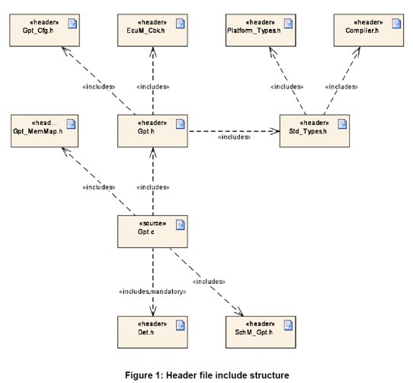
FILE STRUCTURE

Slide 12
03. GPT NOTIFICATION FUNCTION

Slide 13
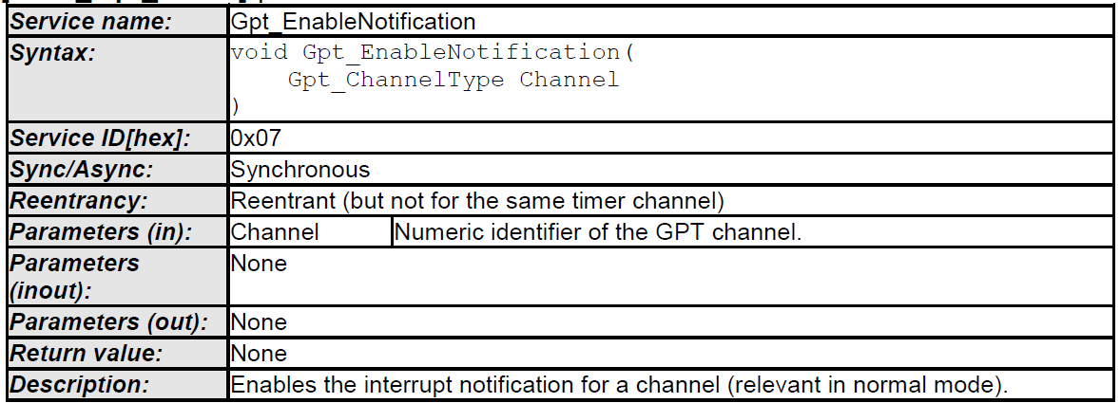
GPT_ENABLENOTIFICATION

Slide 14
GPT_ENABLENOTIFICATION
The function Gpt_EnableNotification shall enable the interrupt notification of the referenced channel configured for notification (see also SWS_Gpt_00233). The function shall save an attribute like "notification enabled" of the channel.
The function Gpt_EnableNotification shall be reentrant, if the timer channels used in concurrent calls are different.
The function Gpt_EnableNotification shall be pre compile time configurable On/Off by the configuration parameter: GptEnableDisableNotificationApi.
If development error detection is enabled for GPT module: If the driver is not initialized, the function Gpt_EnableNotification shall raise the error GPT_E_UNINIT.
If development error detection is enabled for GPT module: If the parameter Channel is invalid (not within the range specified by configuration), the function Gpt_EnableNotification shall raise the error GPT_E_PARAM_CHANNEL.
If development error detection is enabled for GPT module: If no valid notification function is configured (GptNotification), the function Gpt_EnableNotification shall raise the error GPT_E_PARAM_CHANNEL.

Slide 15
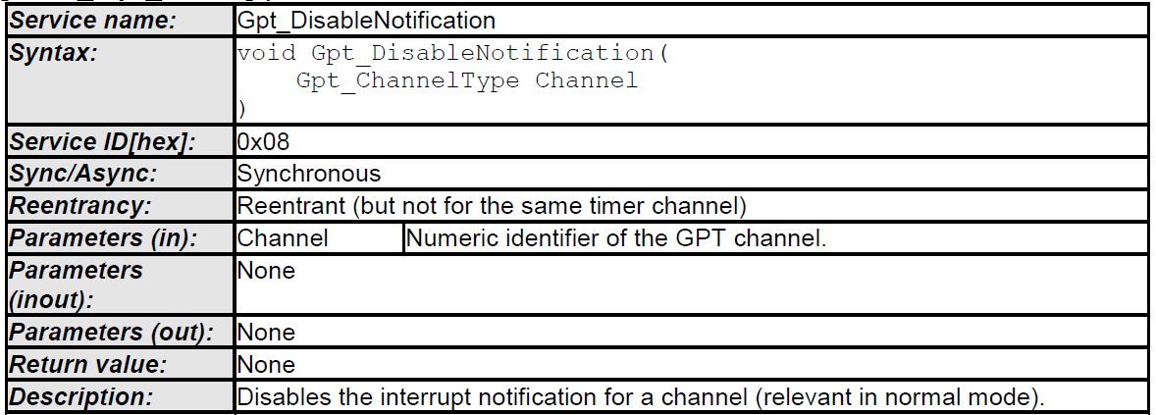
GPT_DISABLENOTIFICATION

Slide 16
GPT_DISABLENOTIFICATION
The function Gpt_DisableNotification shall disable the interrupt notification of the referenced channel configured for notification (see also SWS_Gpt_00233). The function shall save an attribute like "notification disabled" of the channel.
The function Gpt_DisableNotification shall be reentrant, if the timer channels used in concurrent calls are different.
The function Gpt_DisableNotification shall be pre compile time configurable On/Off by the configuration parameter: GptEnableDisableNotificationApi.
If development error detection is enabled for GPT module: If the driver is not initialized, the function Gpt_DisableNotification shall raise the error GPT_E_UNINIT.
If development error detection is enabled for GPT module: If the parameter Channel is invalid (not within the range specified by configuration), the function Gpt_DisableNotification shall raise the error GPT_E_PARAM_CHANNEL.
If development error detection is enabled for GPT module: If no valid notification function is configured (GptNotification), the function Gpt_DisableNotification shall raise the error GPT_E_PARAM_CHANNEL.

Slide 17
04. LM393 SPEED SENSOR

Slide 18

SOLUTION PROPOSAL
Investigate the integration manual and user manual for both MCU and GPT Module to verify the necessary files needed for compilation and configuration.
Investigate the LM393 Speed Sensor
Add necessary configuration for both MCU and GPT module in EB Tresos.
Create a 1 sec timer interrupt using gpt module and 1 external interrupt by enabling the ISF flag and Interrupt of port to get the RPM
Verify the test case by checking the timer interrupt
if it provide the desired time interval
Verify the test case by checking the external interrupt IRQ Handler if it detects the sensor digital input

Slide 19
REQUIREMENT ANALYSIS
Create a program to read the RPM of the DC motor in GPT Notification function of GPT (channel 0) using FTM channel).
Duration of timeout during runtime is 1 s.
Create an external interrupt in Port C pin 15 for the pinout of DO of LM393 module

Slide 20
DOCUMENTS
AUTOSAR_MCAL_GPT_IM
AUTOSAR_MCAL_GPT_UM
AUTOSAR_MCAL_MCU_IM
AUTOSAR_MCAL_MCU_UM
AUTOSAR_PORT_MCU_IM
AUTOSAR_PORT_MCU_UM
AUTOSAR_SRS_PORTDriver
AUTOSAR_SWS_PORTDriver
AUTOSAR_SRS_GPTDriver
AUTOSAR_SWS_GPTDRIVER
S32K144 Reference Manual Rev. 1 Draft H, 02/2016
S32K1xx Series Reference Manual Supports S32K116, S32K118, S32K142, S32K144, S32K146, and S32K148 Rev. 7, 04/2018

Slide 21



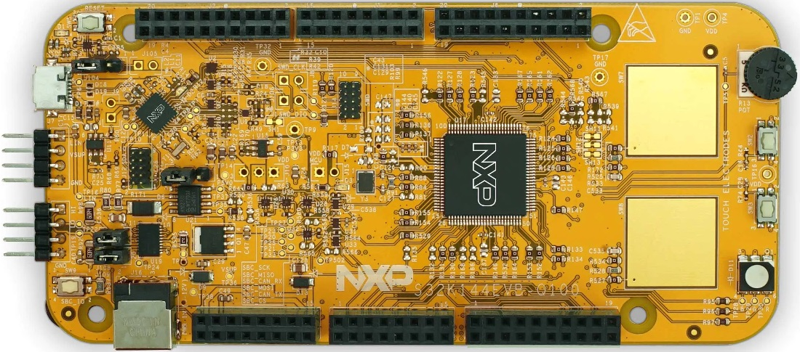

TOOLS NEEDED

Slide 22
SOLUTION PROPOSAL
Investigate the integration manual and user manual for both MCU and GPT Module to verify the necessary files needed for compilation and configuration.
Add necessary configuration for DIO, PORT, MCU and GPT module in EB Tresos.
Create a program to blink led in GPT Notification function of GPT channel 0) using FTM channel)
Produce 1ms, 5ms, 10ms duration timeout that can be change during runtime
Verify the output by checking the led of which color is on
Verify each test using oscilloscope

Slide 23
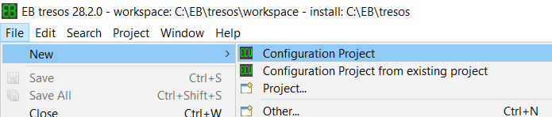
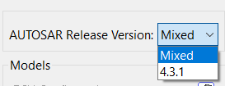
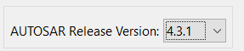
EB TRESOS CONFIGURATION
Create a new configuration project
Select AUTOSAR release version 4.3.1

Slide 24
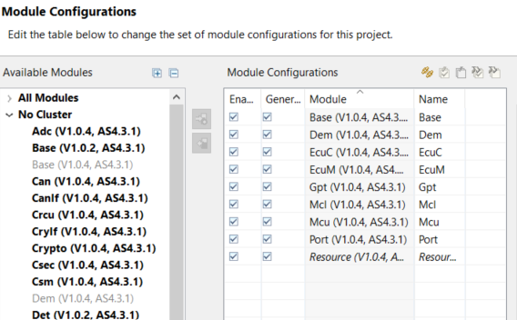
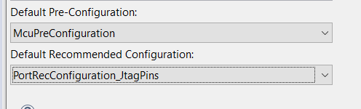
EB TRESOS CONFIGURATION
Setup module configuration
Setup configuration on the Port and Dem (V1.0.4.AS4.3.1)

Slide 25
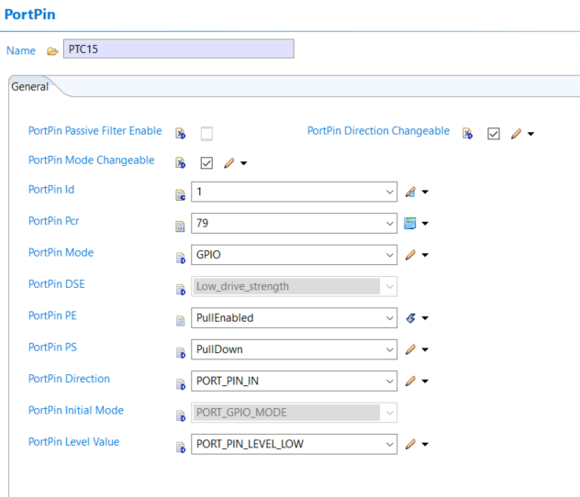
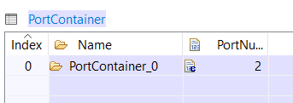
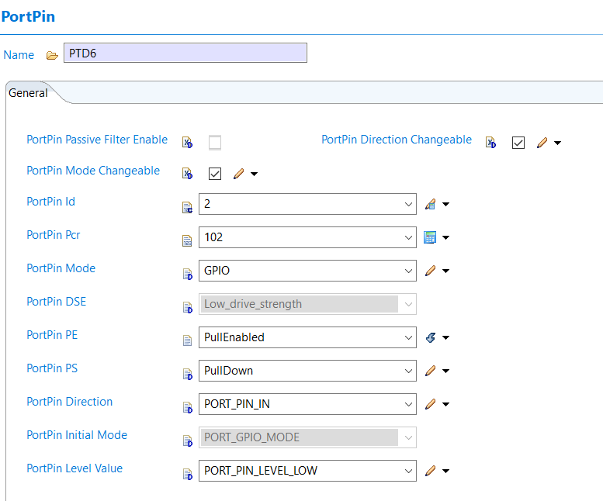
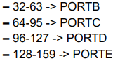
EB TRESOS CONFIGURATION: PORT Module
Hardware Resources for PortPin PCR
Port C:
PTC15 : 64 + 15 = 79
Port D:
PTD16 : 96 + 6 = 102
Create port container to activate and manipulate input and output peripheral

Slide 26
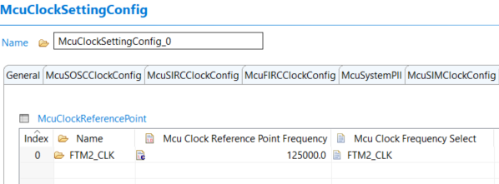
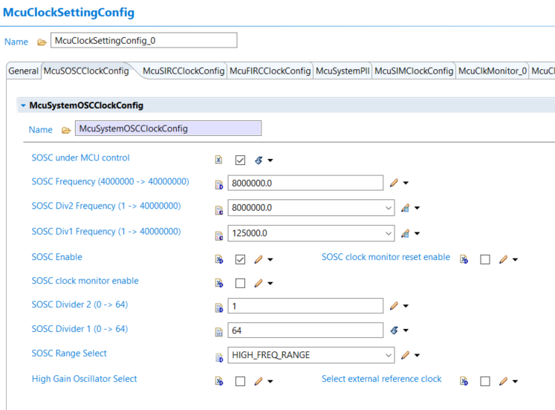
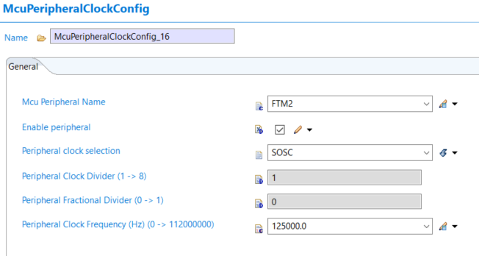
EB TRESOS CONFIGURATION: MCU Module
MCU MODULE CONFIGURATION:
Clock reference configuration for GPT Module
Since SOSC was default enable, it is utilized as the clock source for GPT.

Slide 27
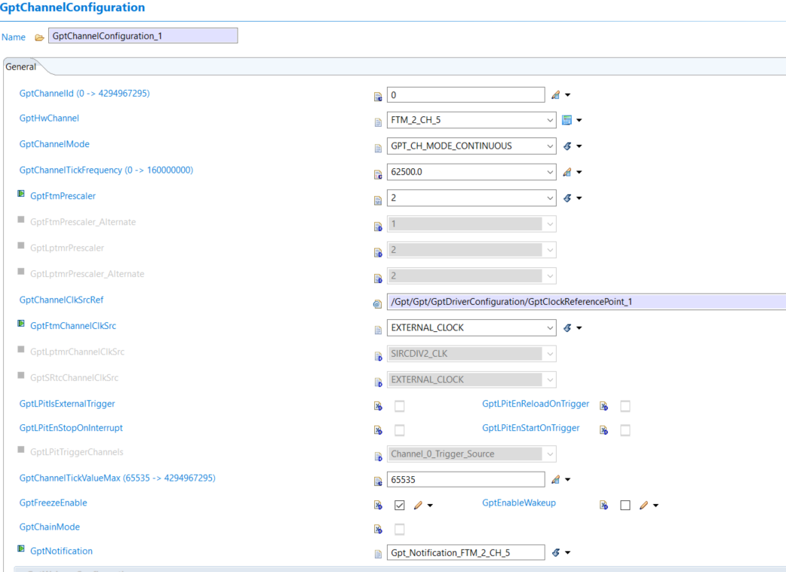
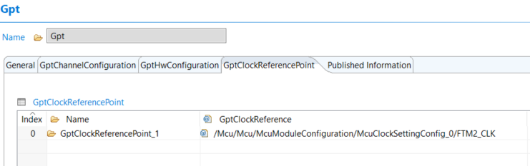
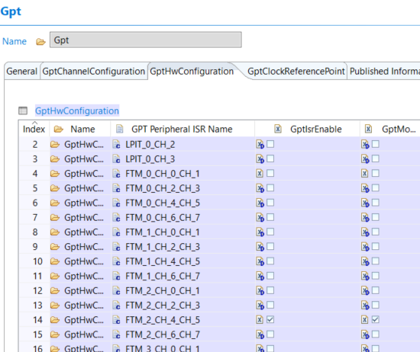
EB TRESOS CONFIGURATION: GPT Module
GPT MODULE CONFIGURATION:
Setup the reference for the container configure in the MCU Module.
Set the GptFtmPrescaler to 2, to achieve 62.5KHz . In which all the configuration shown above will be called using the Gpt_FTM2_Notification.
Enable the GPT ISR and GPT modules used for FTM_2_CH_4_CH_5

Slide 28
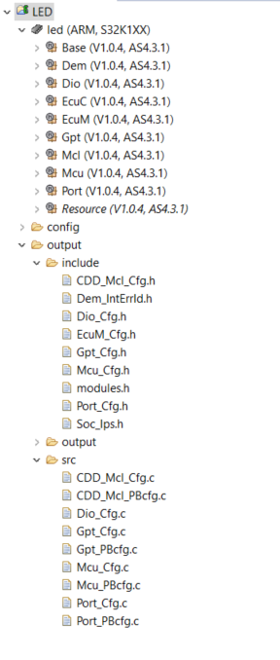
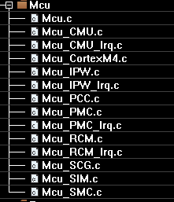
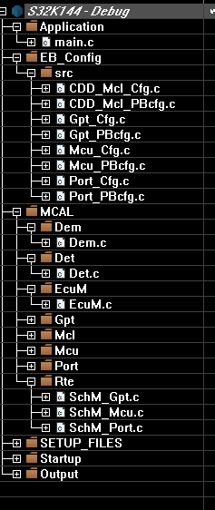
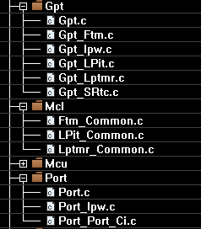
SEQUENCES
Create a new project and Import the Configured files and Static Codes into the IAR EWARM IDE

Slide 29
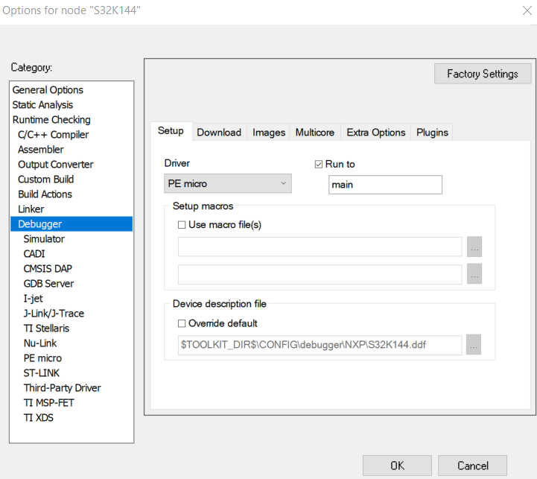
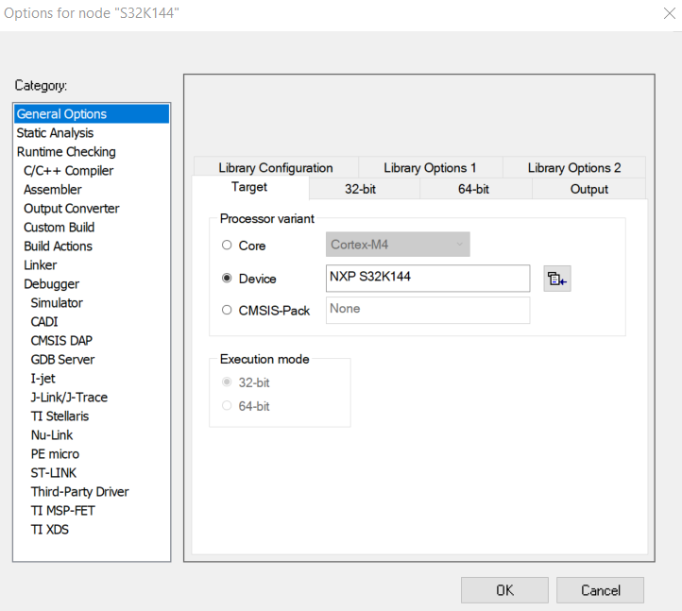
IAR EWARM project option (Device, Debugger)
Setup options need to be configured in IAR EWARM

Slide 30
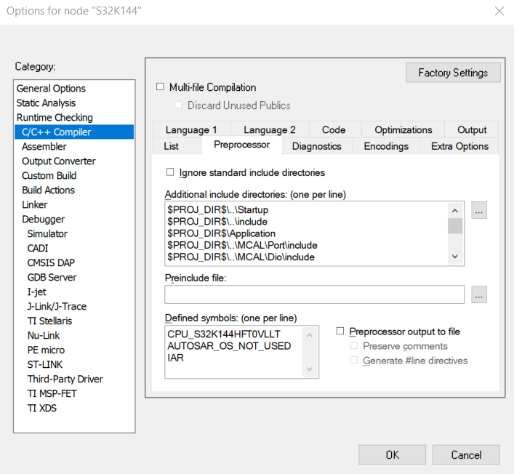
IAR EWARM project option (preprocessor)
ADDITIONAL INCLUDE DIRECTORIES
$PROJ_DIR$\..\Startup
$PROJ_DIR$\..\include
$PROJ_DIR$\Application
$PROJ_DIR$\..\MCAL\Det\include
$PROJ_DIR$\..\MCAL\Base\include
$PROJ_DIR$\..\MCAL\Rte\include
$PROJ_DIR$\..\MCAL\Dem\include
$PROJ_DIR$\..\MCAL\Mcu\include
$PROJ_DIR$\..\MCAL\Mcl\include
$PROJ_DIR$\..\MCAL\Gpt\include
$PROJ_DIR$\..\MCAL\EcuM\include
$PROJ_DIR$\..\MCAL\Port\include
$PROJ_DIR$\..\SETUP_FILES\include
$PROJ_DIR$\..\ConfigGPIOLed\output\include
DEFINED SYMBOLS
CPU_S32K144HFT0VLLT
AUTOSAR_OS_NOT_USED
IAR
open option of the project and click the C/C++ Compiler and go to preprocessor to setup include directories and symbols

Slide 31
CODE IMPLEMENTATION

Slide 32
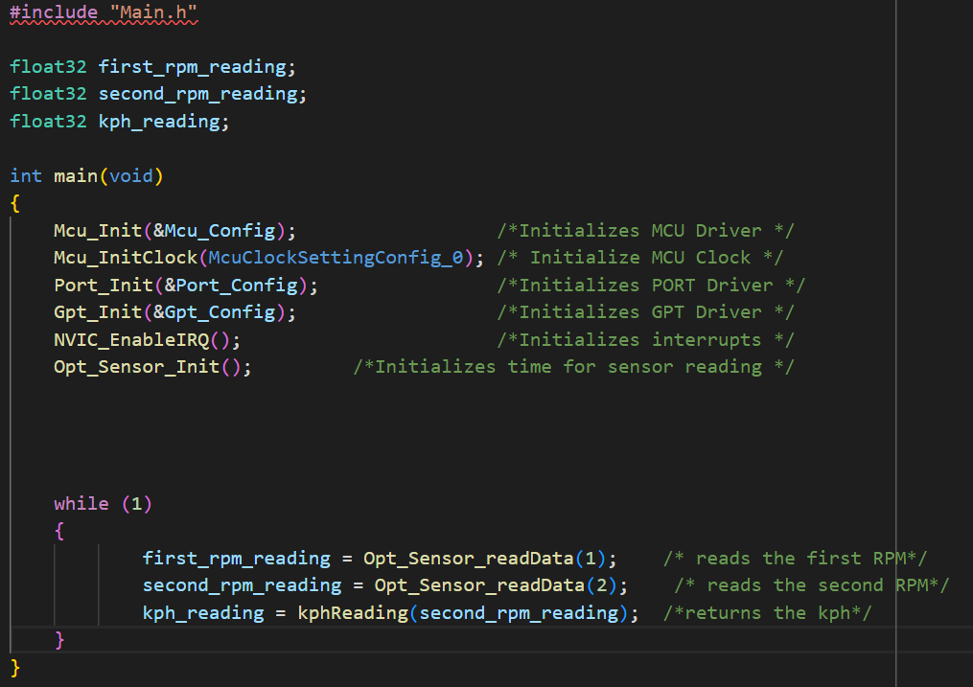
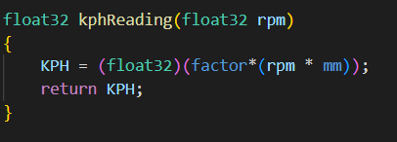
main.c
Initializes all necessary drivers MCU, PORT, GPT and also FTM interrupt and Port external interrupt
Initialize the timer interrupt by calling NVIC_EnableIRQ()
Calling Opt_Sensor_Init initializes time for sensor reading
In the while loop returns the first rpm reading and second rpm reading and also returns kph

Slide 33
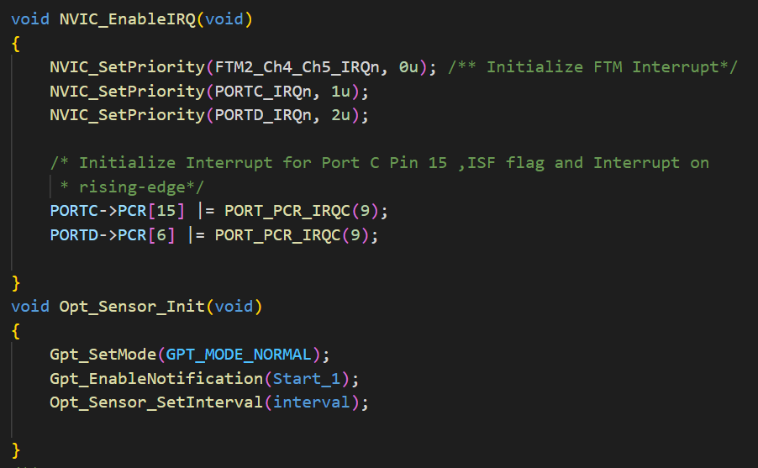
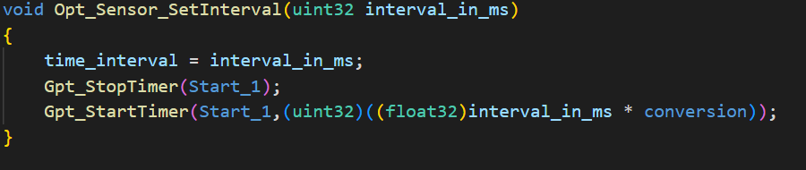
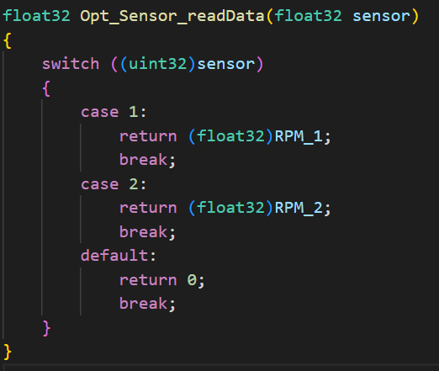
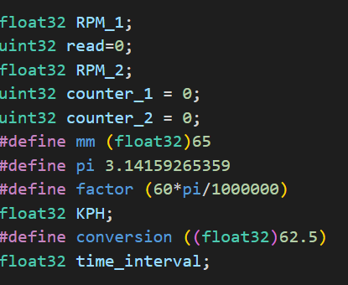
LM393_Speed_Sensor.c
In Opt_Sensor_Init function set mode to normal, enabled the Notification and
In Opt_Sensor_SetInterval function start the timer to produce a 1 second runtime duration.
In Opt_Sensor_readData function returns the RPM value of which is being called

Slide 34
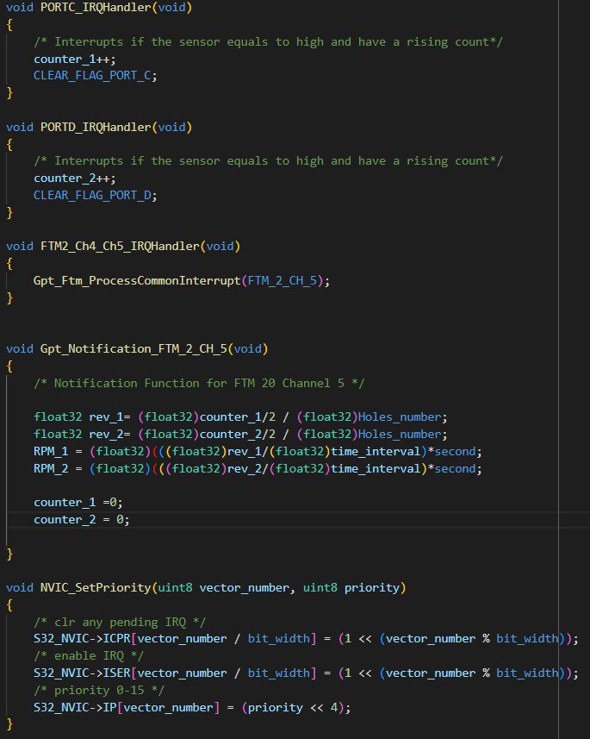
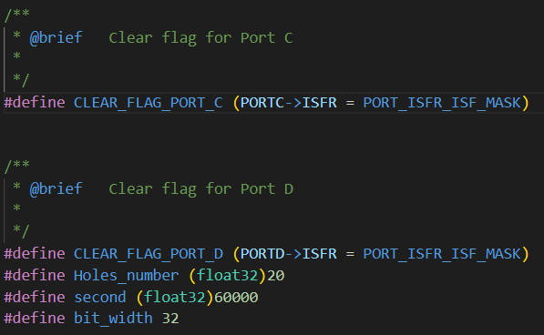
External interrupt IRQ handler handles the input of the LM393 speed sensor
when the external interrupt occurred, we have to set a counter that counts upward
And when the 1s timer interrupt occurred we call the gpt notification under the we can now calculate RPM of the motor…
ISER is for enabling registers in the Nested Vector Interrupt Control (NVIC).
ICPR is for clearing pending registers when a program is executing, and it needs to be interrupt for another activity.
IP gives priority to the recent interrupt function, and it activates also the ISR and focuses on the process between the MCU and the peripheral which requested an interrupt.

Slide 35


